Slide 1
WEB SEARCHING
UNIT - 5

Slide 2
Introduction
A web search engine is a software system designed to search for information on the World Wide Web. The search results are generally presented in a line of results often referred to as search engine results pages (SEROs). The information may be a mix of web pages, images, and other types of files. Some search engines also mine data available in databases or open directories.

Slide 3
Challenges
• Distributed data
– Data spans over many computers and platforms
-Available bandwidth and reliability on the network interconnections varies widely
• High percentage of volatile data
– New computers/sites/pages can be added and removed easily
– We also have dangling links etc. when domain or file names change or disappear
• Large volume
– Scaling issues difficult to cope with

Slide 4
• Unstructured and redundant data
– No conceptual structure/organization
– HTML pages are only semi-structured
– Much data is repeated (copies/mirrors)
• Quality of data
– There is no editorial process data can be false, invalid, poorly written, with many typos
• Heterogeneous data
– Multiple media types, multiple formats
– Different languages, different alphabets

Slide 5
Web Directories
A web directories is a list of website that is organized by category.
Web directories are populated through application and approval process, as opposed to search engine, which utilize web crawlers to visit website and gather data for indexation.

Slide 6
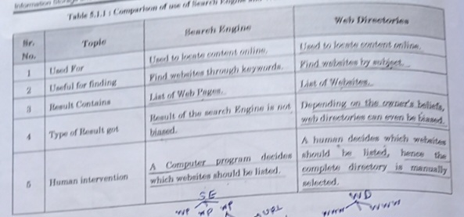

Slide 7
Web Characteristics
1)Measuring the Web :
"Web measuring" typically refers to the process of quantitatively and qualitatively assessing various aspects of websites or online content, often for purposes such as analytics, optimization, or research. It involves gathering data on website performance, user behavior, and content effectiveness to make informed decisions and improvements.

Slide 8
2) Modeling the Web :
Web modeling is the process of creating abstract representations or models of web systems and applications to better understand, plan, and design their structure, behavior, and user interfaces. It involves various types of models, including structural, behavioral, and UI models, to facilitate effective web development and communication among stakeholders.

Slide 9
Architecture of Search Engine
1) Centralized Architecture: -
In a centralized architecture, all search engine components, including web crawling, indexing, and query processing, are typically managed and operated from a single location or data center.
Web crawlers are responsible for fetching web pages, and the collected data is processed, indexed, and stored centrally.
Query processing involves searching the central index and returning results to users.
- Centralized architectures are easier to manage and scale initially but may face limitations in handling large-scale data and user demands.

Slide 10
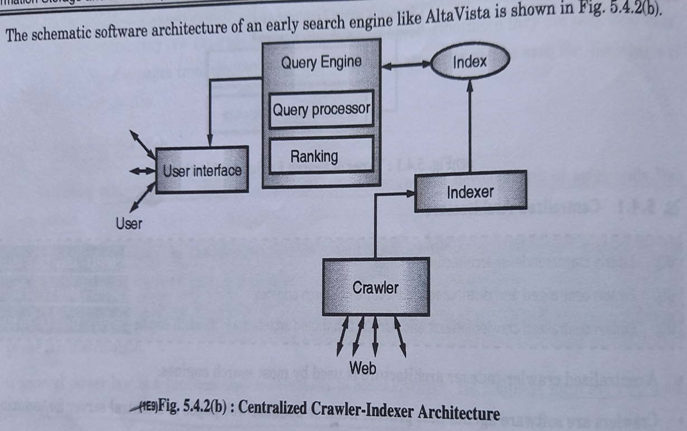

Slide 11
2) Distributed Architecture:
In a distributed architecture, various components of the search engine are spread across multiple servers or data centers, often in different geographical locations.
Web crawling can be distributed, with multiple crawlers operating in parallel to collect web data from various sources.
Indexing is typically done in a distributed manner, where data is partitioned and processed on multiple servers to create a distributed index.
Query processing also involves distributed operations, with query requests being sent to multiple servers or nodes that collectively provide search results.
- Distributed architectures are designed to handle large-scale data and traffic efficiently and are often used by major search engines to ensure speed and reliability.

Slide 12
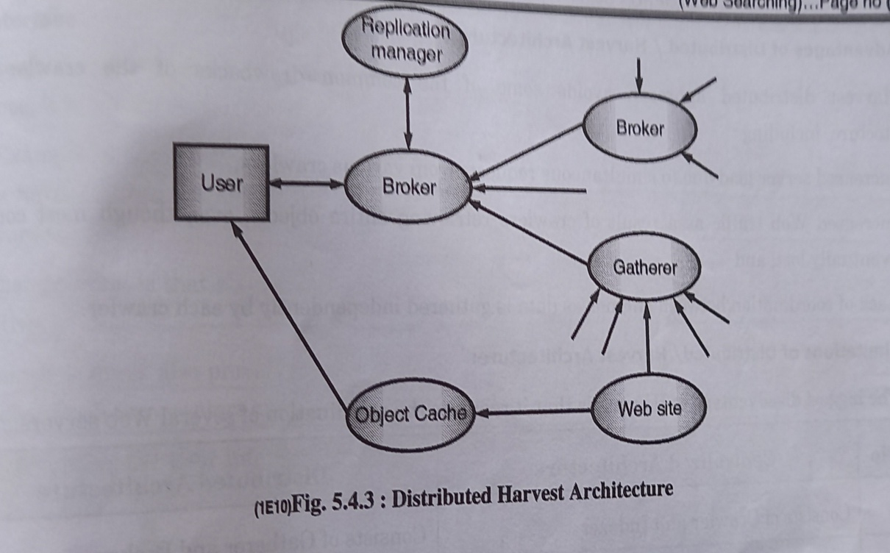

Slide 13
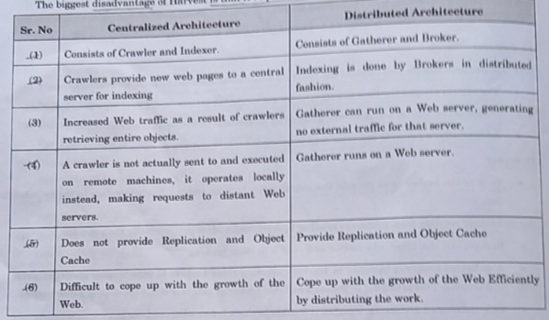

Slide 14
User Interface
User interfaces for web searching typically include a search bar where users can enter their queries, and often a search button to initiate the search. Additionally, search results are displayed in a list format, with relevant information such as titles, snippets, and URLs. Filters and sorting options may also be provided to refine search results. Modern search interfaces often incorporate features like autocomplete suggestions, voice search, and visual search for enhanced user experience. Search engines like Google, Bing, and DuckDuckGo continually refine their interfaces to improve usability and relevance of results.

Slide 15
Ranking in Search Engine
Ranking in web searching refers to the order in which search engine results are displayed when you perform an online search. Search engines like Google use complex algorithms to determine the ranking of web pages based on various factors, including relevance, quality of content, keywords, backlinks, and user engagement. Websites that are deemed most relevant and trustworthy for a particular search query are typically displayed at the top of the search results, while less relevant or lower-quality websites are ranked lower. SEO (Search Engine Optimization) is the practice of optimizing a website to improve its ranking in search results.

Slide 16
Challenges in Ranking
Creating a suitable evaluation process that enable assessing a ranking’s effectiveness in term of its relevance to users.
Finding good quality content on the Web.
Defining the ranking function and computing it.

Slide 17
Page Rank
• Part of Google’s ranking algorithm
• Simulates a user navigating randomly in the Web
– the user jumps to a random page with probability q or
– follows a random hyperlink (on the current page) with probability 1-q
• This user never goes back to a previously visited page following an already traversed hyperlink backwards
• The probability of being in each page can be computed -> the value is used to estimate the quality of the page

Slide 18
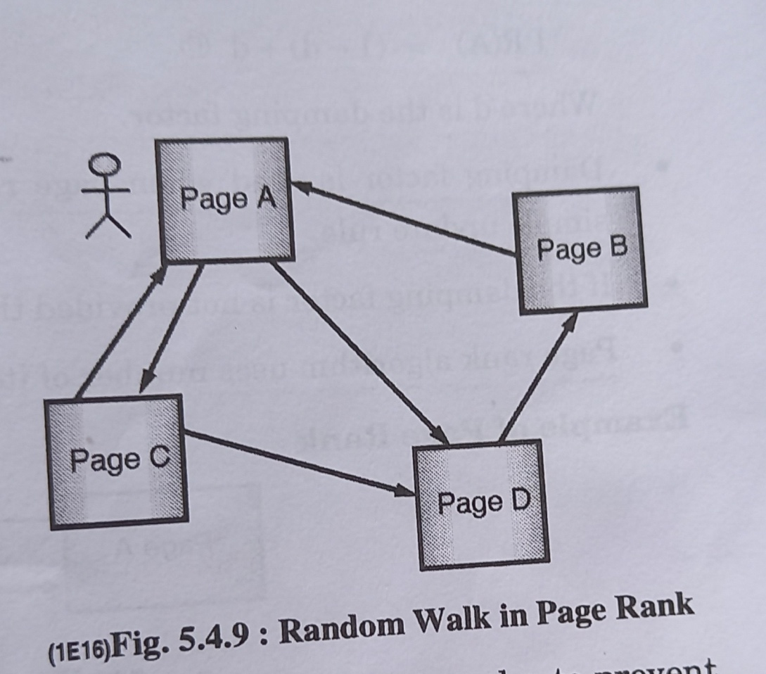

Slide 19
Web Crawling
Web crawling is the process by which automated bots, known as web crawlers or spiders, systematically browse the internet to index and gather information from websites. These crawlers navigate through web pages, following links from one page to another, and collecting data such as text, images, and links. Web crawling is an essential part of search engines like Google, as it enables them to build a searchable index of web content, making it possible for users to find relevant information when they perform online searches. Web crawlers are also used for various other purposes, including data mining, content scraping, and website monitoring.

Slide 20
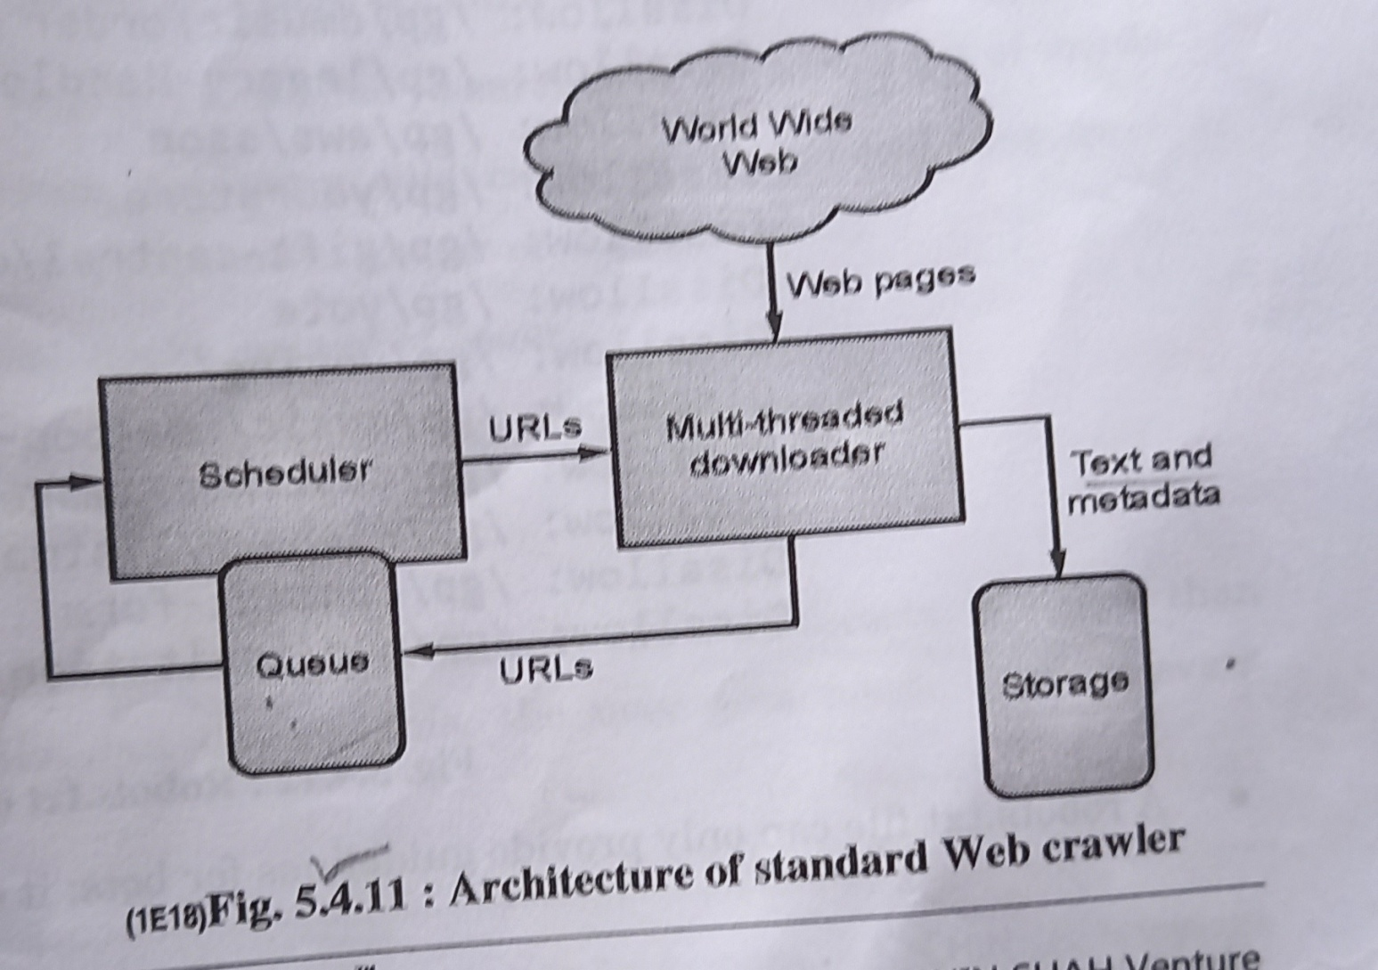

Slide 21
Crawling web pages using URLs:
1. Collect a list of URLs.
2. Send HTTP requests to each URL.
3. Parse HTML content.
4. Extract desired data.
5. Follow links if needed.
6. Store data.
7. Implement throttling and respect robots.txt.
8. Ensure ethical and legal scraping.

Slide 22
Indices
Indices and inverted files are essential for enabling efficient and fast web searching, as they allow search engines to sift through vast amounts of web content and provide users with relevant results.
The inverted file is constructed from the index. It organizes terms alphabetically or numerically and maintains a list of document IDs where each term appears. This helps the search engine quickly locate documents containing specific terms.
Search engines crawl the web to collect web pages and their content. This index includes information like the frequency of each term within each document.

Slide 23
Browsing
Browsing in web searching refers to the act of exploring the internet by visiting websites and web pages to find information, entertainment, or engage in various online activities. When you browse the web, you typically use a web browser (e.g., Chrome, Firefox, Safari) to access websites by entering URLs or clicking on links. Browsing allows you to view and interact with content on the World Wide Web, including text, images, videos, and interactive applications. It's a fundamental aspect of using the internet to access a wide range of information and services.

Slide 24
Meta Searchers
Meta search engines, also known as meta searchers or meta search platforms, are specialized search tools that aggregate search results from multiple individual search engines and directories. Instead of querying a single search engine like Google or Bing, meta search engines simultaneously send your search query to multiple search engines and then compile and present the results from those sources in a unified list. Meta search also run on the client.

Slide 25
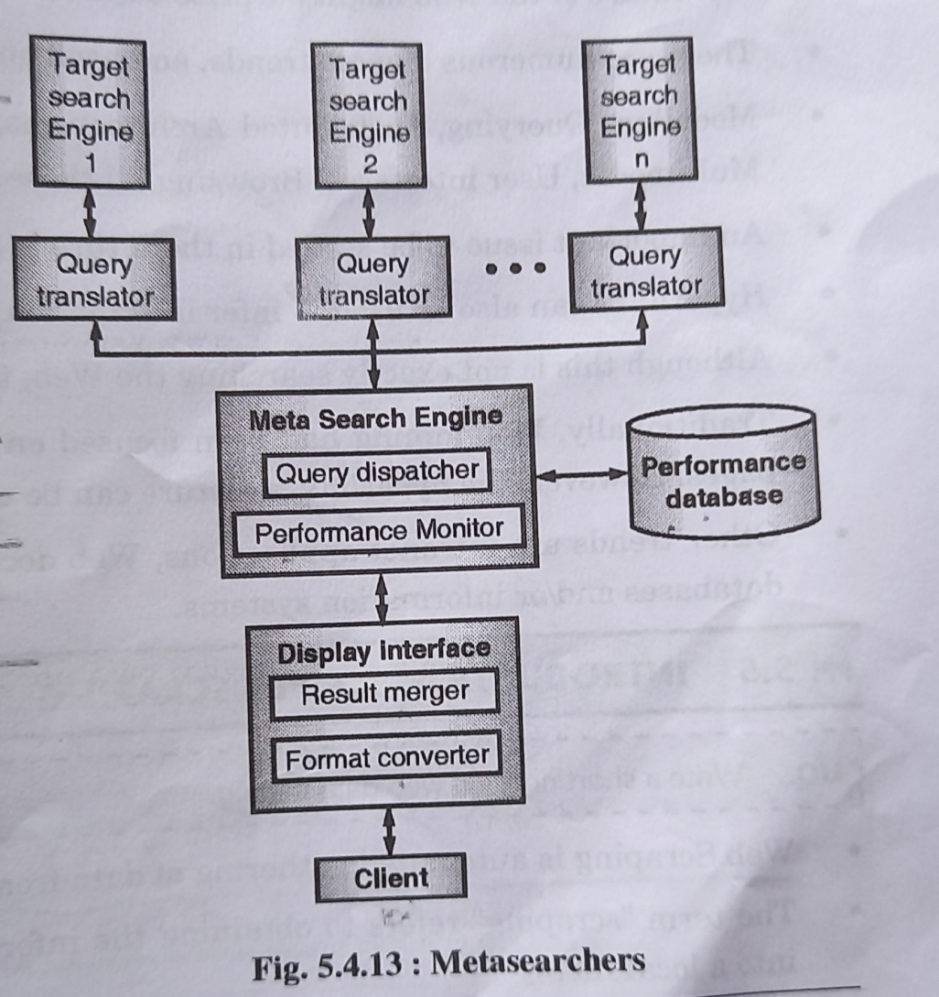

Slide 26
Advantages of Meta Search Engines:
Comprehensive results from multiple search engines.
Time-saving by querying multiple sources at once.
Reduced bias in search results.
-Useful for broad or exploratory searches.
Disadvantages of Meta Search Engines:
May lack depth in results.
Limited advanced search features.
Inconsistent result quality.
Slower performance when querying multiple engines.
- Lack of personalization in results.

Slide 27
Searching using Hyperlinks
Searching using hyperlinks typically involves navigating the web by clicking on links within web pages or documents.
1. Clicking Hyperlinks: When you're browsing a webpage or reading a document (like a PDF or an eBook) that contains hyperlinks (highlighted and underlined text or images), you can click on these hyperlinks.
2. Navigation: Clicking a hyperlink will take you to another webpage or resource related to the linked text or image. This is a way to quickly move from one webpage to another or to access additional information.
3. Search Engines: Many hyperlinks on the web lead to search engine results pages (SERPs) or specific search queries. For example, you might click a hyperlink that says "Learn more about space exploration," and it could take you to a search engine with results for that topic.

Slide 28
Trends and Research Issues
Certainly, here are some trends and research issues in search engines:
Trends:
1.AI and Machine Learning : Incorporating AI and ML for better understanding of user intent and content relevance.
2. Voice Search : Optimization for voice-activated search on smart devices.
3. Mobile-First Indexing : Prioritizing mobile-friendly content due to the increasing use of mobile devices.
4. Personalization : Delivering personalized search results based on user preferences and behavior.
5. E-A-T (Expertise, Authoritativeness, Trustworthiness) : Ensuring content quality and credibility for ranking purposes.

Slide 29
Research Issues:
1. Semantic Search : Improving the understanding of context and user intent in search queries
2. Privacy and Security : Balancing personalized results with user privacy concerns.
3. Multilingual Search : Enhancing search engines' capabilities to handle diverse languages and dialects.
4. Query Understanding : Developing better techniques for interpreting complex search queries.
5. Content Quality Assessment : Refining algorithms to assess the trustworthiness and relevance of web content.

Slide 30
Introduction to Web Scraping
Web scraping is the automated process of extracting data from websites. It allows you to retrieve information from web pages, such as text, images, prices, or any other structured data, and use it for various purposes like data analysis, research, or building applications.
Web scraping can be a powerful tool when used responsibly, but it's crucial to follow best practices, respect website policies, and be mindful of the potential legal and ethical implications.

Slide 31
Python for Web Scraping
Python is a popular choice for web scraping for several reasons:
1. Ease of Use: Python has a simple and readable syntax, making it accessible to beginners and experienced programmers alike. This makes it easier to write and maintain web scraping code.
2. Robust Scraping Libraries: As mentioned, Python has dedicated libraries like BeautifulSoup and Scrapy that are specifically designed for web scraping. These libraries provide features like parsing HTML, handling HTTP requests, and even following links on web pages.
3. Cross-Platform Compatibility : Python is available on multiple platforms (Windows, macOS, Linux), ensuring your scraping code can run on different operating systems.

Slide 32
4. Data Processing Capabilities: Python offers excellent data processing capabilities with libraries such as pandas and NumPy. After scraping data, you can easily clean, manipulate, and analyze it using these libraries.
5. Third-Party APIs: Python has libraries to interact with various APIs, making it easier to access structured data from websites that offer API endpoints.
6. Community Support: Python has a large and active community of developers. This means you can find plenty of tutorials, documentation, and online forums to help you with your web scraping projects.

Slide 33
Steps for web scrapping
Find the URL that you want to scrape.
Inspect the page(right click on page and select the inspect element).
Write the code.
Store the data in the required standard format.
Before actual web scrapping, you must first install the requests module and beautiful soup package, using following commands:
pip install beautiful soup
pip install requests

Slide 34
Request in Web Scraping
In web scraping, a "request" typically refers to an HTTP request made by a web scraping script to retrieve data from a website. This request is sent to a specific URL, and the server hosting the website responds with the requested data. There are several types of HTTP requests commonly used in web scraping:-
1. GET Request : This is the most common type of request in web scraping. It is used to retrieve data from a specified URL. When you enter a URL into your web browser, it typically sends a GET request to the server, and the server responds with the HTML content of the web page.

Slide 35
2. POST Request : This type of request is used to send data to a server to be processed. It's often used when you need to submit a form on a website. For example, you might use a POST request to search for products on an e-commerce site.
3. API Requests : Some websites offer data through APIs (Application Programming Interfaces). In this case, you send a specific type of request to the API endpoint, and you receive structured data in response, often in JSON or XML format.
4. Cookies : Cookies can be included in requests to maintain session information or track user interactions. This can be important when scraping websites that require authentication or have session-based data.

Slide 36
HTML Parsing
Parsing in web scraping involves sending a request to a web page, receiving a response, parsing the HTML content of the response to extract specific data, cleaning and structuring the data, and then storing or processing it for your needs. This process allows you to extract valuable information from web pages for various purposes.

Slide 37
Beautiful Soap
Beautiful Soup is a Python library used in web scraping to parse and extract data from HTML and XML documents. It simplifies the process of locating and extracting specific information from web pages, making it a valuable tool for web scraping tasks.
Installation of BeautifulSoup:
pip install bs4

